Slide 1
Automated Hydroponics- Soilless Farming
Team Hydra

Slide 2
Proposed Prototype
Our proposed cost-effective solution, Hydroponics, is a method of growing plants in a water based, nutrient-rich solution. Our system does not use soil. Instead, the system is supported by using an inert medium cocopeat and hydroton.
The basic premise behind our system is to allow the plants' roots to come in direct contact with the nutrient solution, while also having access to oxygen, which is essential for proper growth.
The system continuously monitors and controls the pH, nutrient concentration, light, temperature and humidity levels of the closed environment.

Slide 3
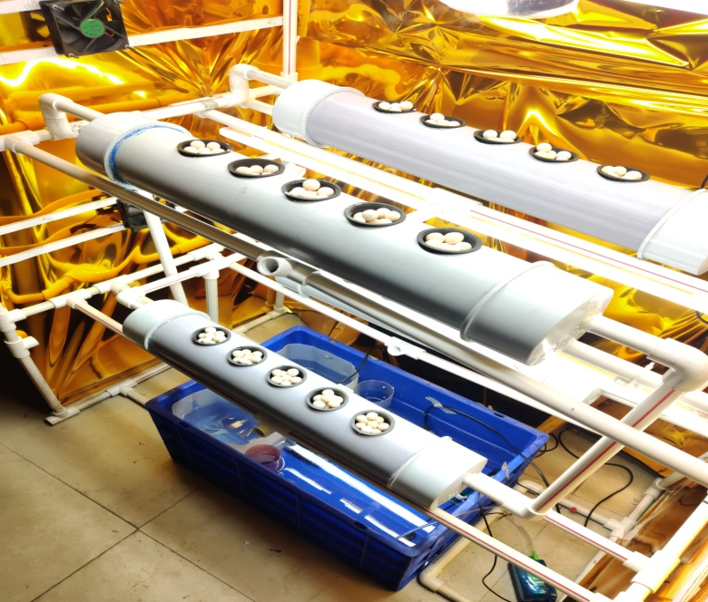
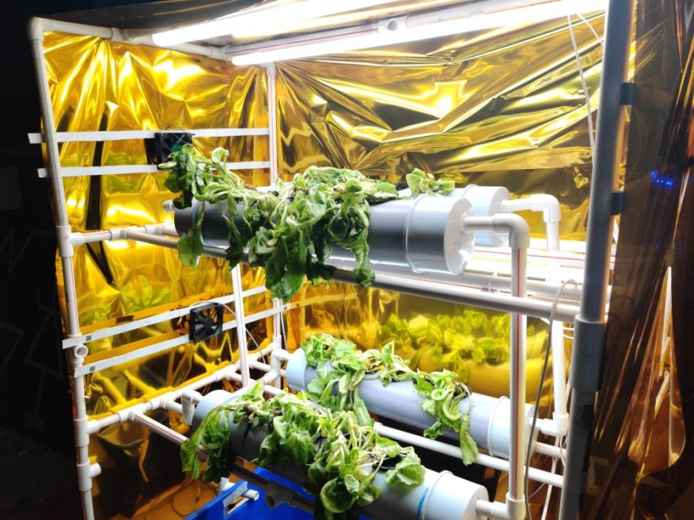
Prototype Pictures
Initial Stage
Growing Stage

Slide 4
How it works?
Step 1: Sense the values of the EC, pH, Temperature and Humidity sensors.
Step 2: Check if the values of these parameters match the requirements of the plant.
Step 3: If any unwanted value is encountered, inform the necessary actuator to take action accordingly.
Step 4: If no action is required, go to Step 1.

Slide 5
Example Scenarios
If the required pH value for the plant is 6.5 and the pH sensor gets a reading of 7.0, the pH reducer actuator will be automatically triggered. pH reducers will be added to the container to reduce the pH value to match its required value.
The nutrient concentration is measured in terms of the electrical conductivity of the medium. If the EC reports a higher concentration than required, the solution is diluted and vice-versa.

Slide 6
Traditional Farming Hydroponics
90% water seeps through the soil and drains away.
Yield per unit area is finite.
High Effort and resources usage.
Use of Pesticides and Insecticides.
Requires crop rotation.
Cannot control the growth conditions.
Only requires 10% of the water conventional farming requires.
Yield per unit area multiplies with stacking.
Less effort and resources are used.
No Pesticides / Insecticides required.
No crop rotation required.
Ideal condition for plant growth can be maintained.

Slide 7
Main Components
Communication: WiFi Module, Bluetooth Module, ATMega 328p.
Database: Google Firebase.
Frontend: Android Application.
Sensors: pH, Customized Electrical Conductivity, Temperature, Humidity, Water Level Indicator.
Actuators: Fans, LED grow lights, 12V DC Pumps, AC Pump, Air Pump, Humidifier, Motor Driver.
Miscellaneous Components: PVC Pipes, 8 Channel 5V Relay Module, Light reflector, Cocopeat, Hydroton.

Slide 8
Outreach
Visited neighbouring villages and interacted with farmers in regions in and around Khed Shivapur.
Most of the farmers were frustrated with the conventional farming methods and its irregularities and uncontrollable growth conditions of the plants.
Farmers welcomed the option of growing plants using the automatic hydroponic system.

Slide 9
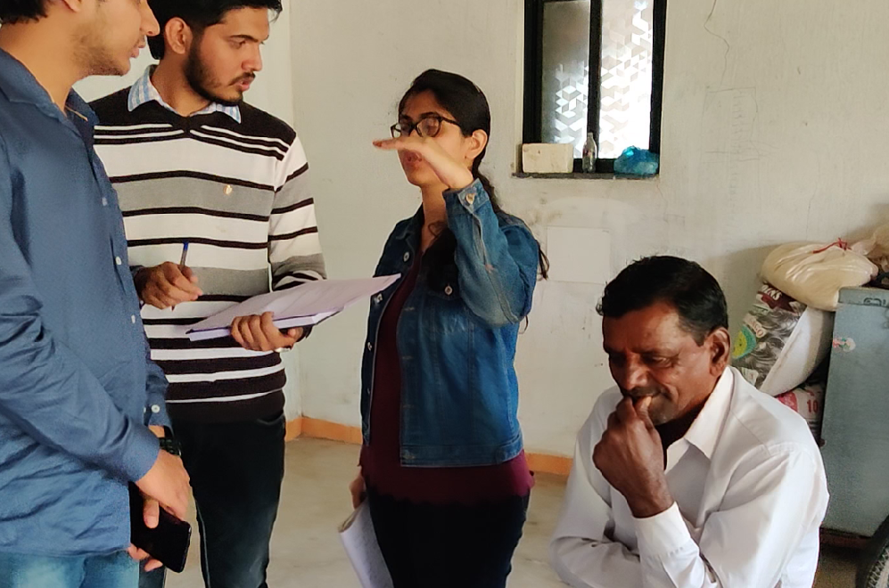
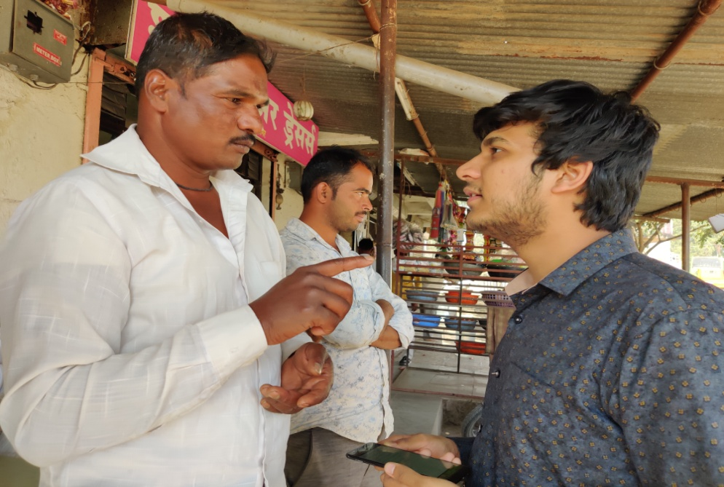
Outreach

Slide 10
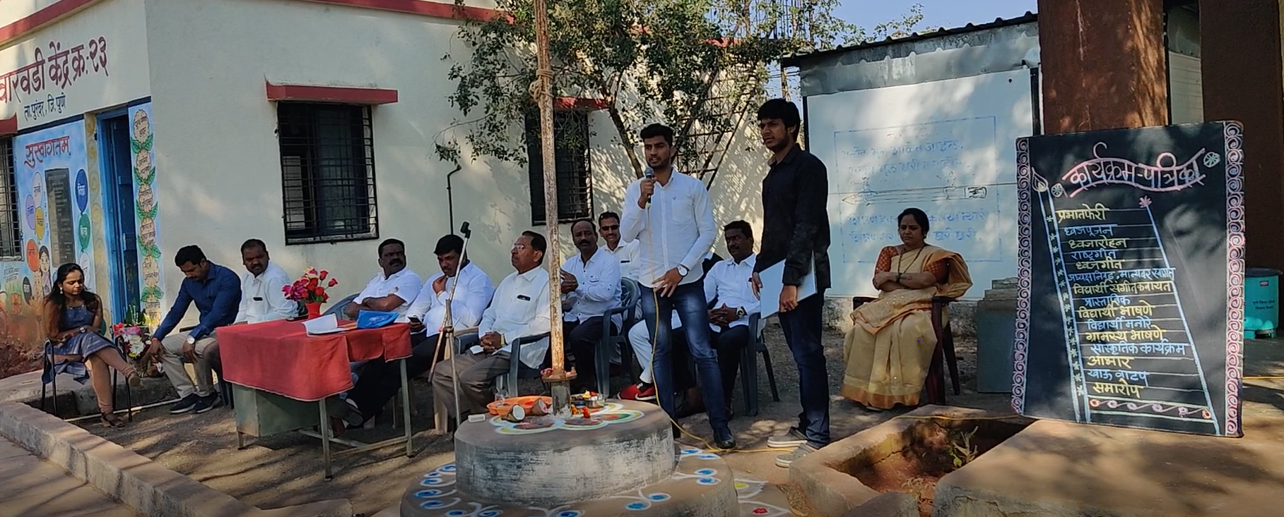
Outreach

Slide 11
Hydroponic Lettuce
pH: 6.4 for seedlings and 6.0 for mature plants.
Nutrient concentration: 750-840 ppm.
Light: 5 to 6 hours/day.
Nutrient: Grows well with 8-15-36 Hydroponic nutrient.

Slide 12
Other plants that can be grown using Hydroponics
Peppers and Herbs: require low pH of around 5.8 and light for 8-10 hours/day.
Tomatoes: Need light for 10-12 hours/day. pH of 6.2 and flower clusters need to be shaken.
Cucumbers: pH between 6.4 to 6.7. Give a lot of fruit but need big spaces.
Strawberries: Commercial crops that require less area. Colder areas preferred.
Spinach.
Radish.
etc.

